Slide 1
EARTHQUAKE INFRASTRUCTURE, TRANSPORTATION & PUBLIC BUILDING CLUSTER Daily Situation Update No. 2
Ministry of Infrastructure & Public Utilities

Slide 2
Agenda
Background
Milestones
Situation Update
Deployment of Assessment Team
Stakeholder’s Feedback & Update
I.T.PB Cluster Request to NDMO
Any Other Business (AoB)

Slide 3
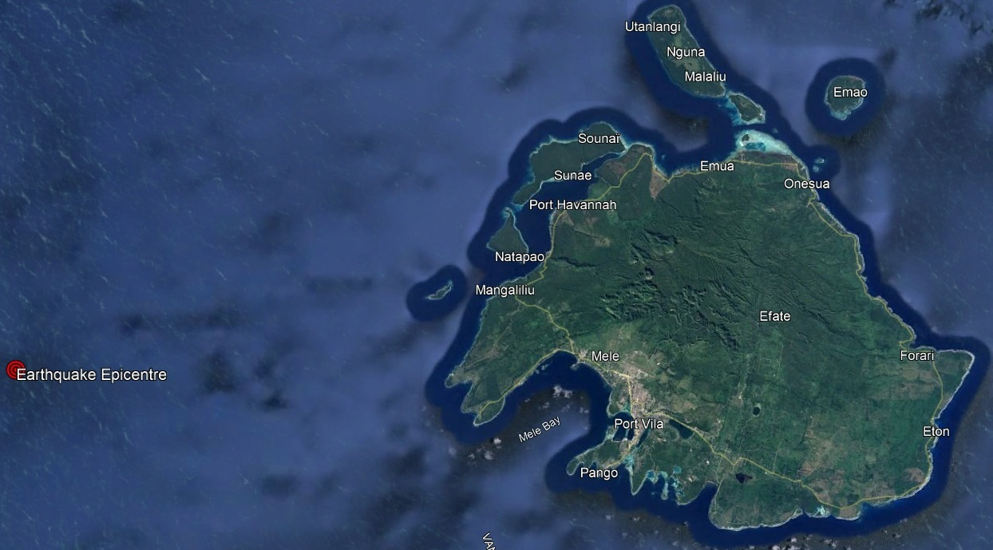
1. Background
An earthquake of magnitude, 7.3 located at 17.7° S and 167.8° E approximately 34km west of Efate and 150km west of Erromango. Around 80,000 people were affected. A state of Emergency is declared throughout the worst affected areas of Vanuatu on the 17th of December 2024. This declaration of State of Emergency is for a period of 7 days from the date on which the order is made.

Slide 4
2. Milestones - Roads
Partial Access (Risk of Landslide) – Road to Lapetasi, Main Wharf & Temporary Domestic Wharf (3 Contractors undertaking landslide clearing: Entreprise Dinh Van Tu, DJ Auto, and Road Stabiliser Process Entreprise Ltd.)
Full Access (Light Vehicle ONLY) – Road to Mele/Bauerfield Int. Airport (Note: Tonnage limitation to be confirmed)
Full Access – Efate Ring Road except at Klem’s Hill, 1-lane (Escofarm undertaking landslide clearing)

Slide 5
2. Milestones – Ports & Harbour
Lapetasi Wharf is operational for international vessels
Main Wharf is operational for international vessels but not accessible

Slide 6
2. Milestones – Public Buildings
Deployment of Assessment Team
39 Buildings Assessed to-date, 5 confirmed structurally not fit – recommend demolition (Lolam Building, DoCIR Office Building, MoL Building, Dream House Shop, & Wong Store)

Slide 7
2. Milestones – Airports
Bauerfield International Airport is operational

Slide 8
3. Situation Update - General
Deployment of Assessment Teams on the 18th of December 2024. Assessment is ongoing.
Development of response plan ongoing, expect tomorrow, 20/12/2024
Expect maps on unsafe buildings
Expect notices on unsafe roads from the Roads Administrator & Police Traffic

Slide 9
3. Situation Update - Roads
Total Road Network: 388.00km
Roads Accessible -
Not Accessible –
99%
1.0%

Slide 10
3. Situation Update – Roads (Cont.)
Name of Infrastructure: TAGABE BRIDGE
Type of Assessment: Visual Assessment
ASSESSMENT
Type of Structure:
8 steel I-Beam structure on Abutment
Arc Amco installed as formwork supporting bridge deck RC concrete.
Abutment is connected to superstructure and visually intact and in sound condition.
The bridge is an important link to the airport, Port Vila’s main Power Station and largest villages, residential areas and commercial business and services. Also main access to town. It was constructed in colonial era hence its life is over due and needs to be replaced as an immediate measure.

Slide 11
3. Situation Update – Roads (Cont.)
DEFECTS:
Spalling of Concrete cover on 6 Steel I-Beam at the end of I-Beam at Town approach (See Photo 1 below)
Both Down Stream Wing wall have cracks and displaced from the abutment walls (Refer to Photos 2 below)
Visual pavement cracks and settlements at town approach of the bridge.
Diagonal cracks seen on the Mele approach downstream approach (See photo 3)
There is no movement in the substructure of the bridge whether sideways of downwards as in settlement.
The settlement experience on the surface pavement could possibly subject to the settlement of the pavement at the town side approach.

Slide 12
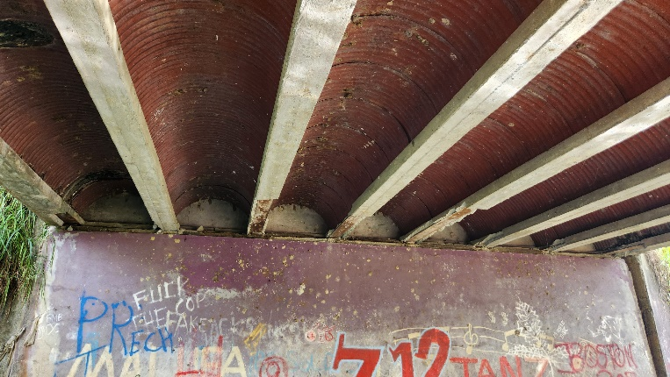
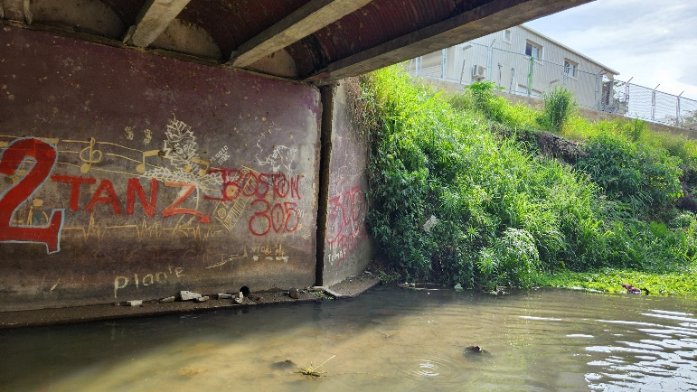
3. Situation Update – Roads (Cont.)
PHOTOS:
Photos showing 8 steel I beam supporting Arc Amco as formwork for RC concrete decking. Note concrete cover spalling off I beams. Not a major structural defects.
Concrete wing wall being separated from bridge abutment wall. The displacement looks old and not caused by earth quake.

Slide 13
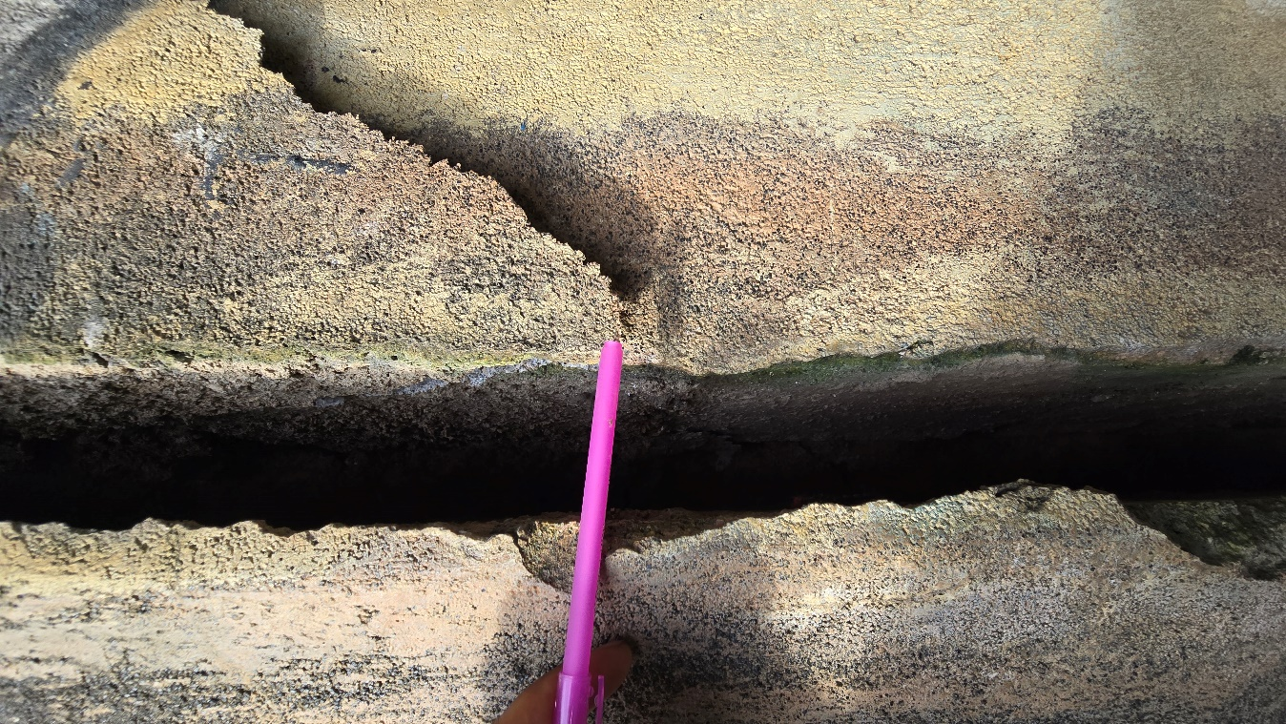
3. Situation Update – Roads (Cont.)
PHOTOS (CONT.):
Crack on the down stream mele approach.

Slide 14
3. Situation Update – Roads (Cont.)
RECOMMENDATION
Bridge structure is currently in sound condition and could be used.
Needs to maintain filling on crack at approach to ensure accessibility and continuous monitoring.
Need inspection of bridge after next earthquakes and aftershocks.

Slide 15
3. Situation Update – Roads (Cont.)
RECOMMENDATION (Cont.)
Traffic is allowed to move across the bridge, but heavy loading needs to be minimized and controlled.
Slowing done of traffic movement to cue traffic on the bridge increasing traffic loading must be avoided.
The bridge needs to be reconstructed as an immediate term measure as the current status cannot guarantee the future stability of the structure.

Slide 16
3. Situation Update – Roads (Cont.)
Name of Infrastructure: WHARF ROAD
Status:
Lapetasi Wharf - Operational
Partial access – Road to Lapetasi, Main Wharf & Temporary Domestic Wharf (3 Contractors undertaking landslide clearing: Entreprise Dinh Van Tu, DJ Auto, and Road Stabiliser Process Entreprise Ltd.)
What’s Next?
Suspend access and operation to Main Wharf
Inform residence at Elluk who are at risk
Continuation of landslide clearing to access Main and Temporary Domestic Wharf.
Risk of further landslide (disturbed/ unstable materials).
Way Forward:
Engage experts from Donor partners to undertake detail assessment on the options and provide recommendations to mitigate the risk of future landslides.

Slide 17
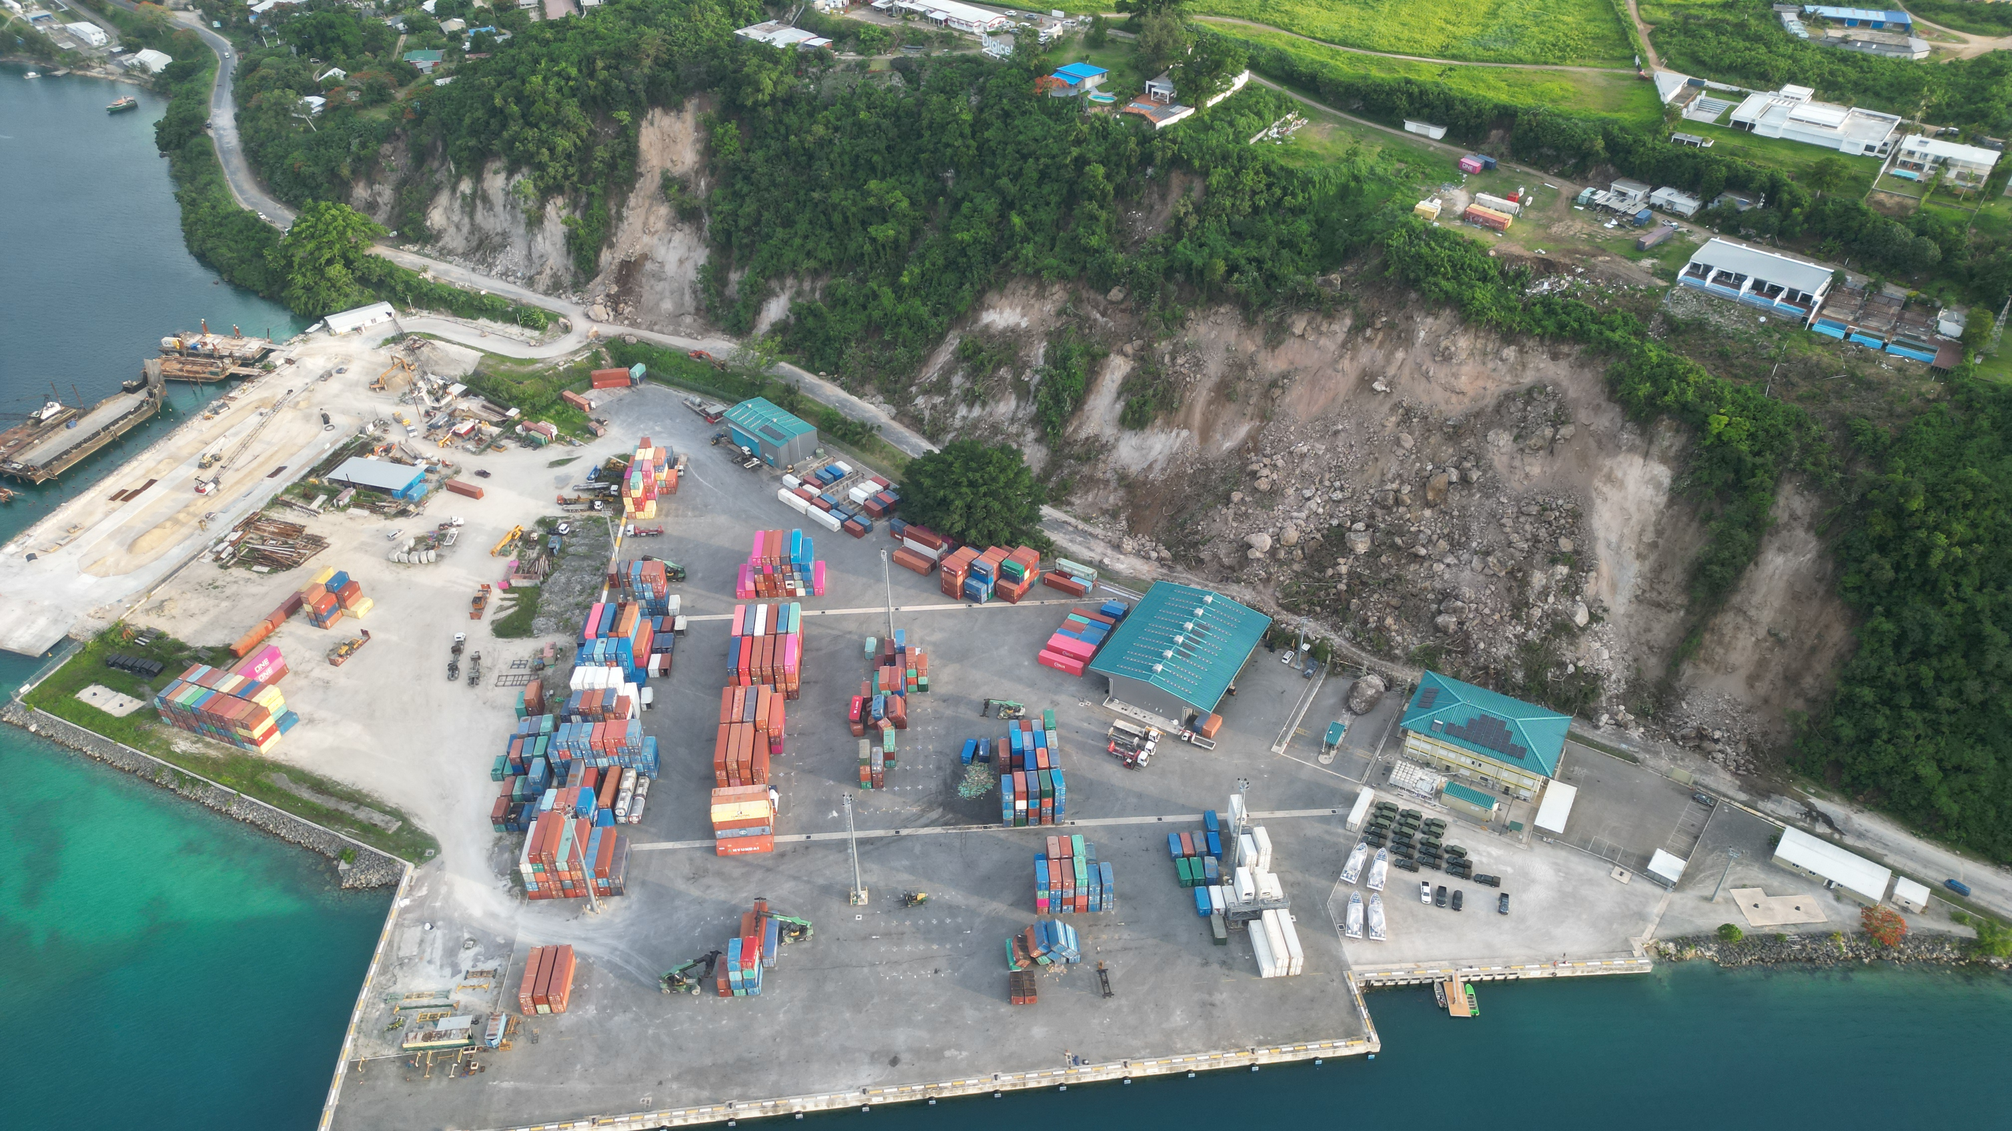
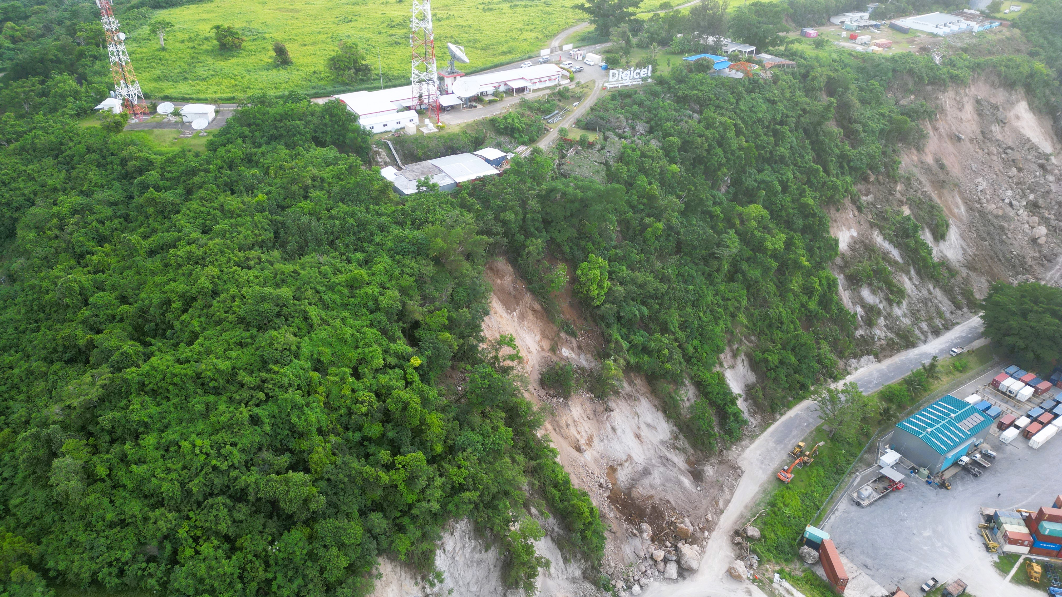
3. Situation Update – Roads (Cont.)
Disturbed/ unstable materials

Slide 18
3. Situation Update – Ports & Harbour
Assessment of Lapetasi Multipurpose Wharf: There is settlement evident from inspection, however, the structure is intact. Berthing can still happen.
Assessment of Main Wharf: There is displacement of about 20-30cm between the main berthing structure and pier. Berthing can still happen.
Detailed assessment report to be provided to fuel supplier
Office Administration: Unsafe to undertake clearing activity
Engineers report to confirm building safety status
GAS and Fuel tankers can still offload at main port – pending line inspection reports by Origin and SSP

Slide 19
3. Situation Update – Ports & Harbour (Cont.)
Cruise ship on the 24th of December will anchor in the harbor
No Access to Domestic wharf – (negotiation for temporary relocation to Sino Van)
VMSA to send instruction to restrict inbound movement of people into Efate

Slide 20
3. Situation Update – Airports
Pavements: Operational. Require Engineering Assessment and Report to provide confidence to international airlines
Airfield Ground Lighting: Operational
Navaids: Operational. NDB (Mele) ground navaid and VHF Comms Tower (Bellevue) requires urgent access to mains power.
Airport Rescue Firefighting Services (ARFFS): Water storage tower collapsed. Require 2x 10,000L tanks and pressure pump (short-term). Water storage tower to be reconstructed and water bore supply installed (long-term).
Air Traffic Control: Operational.

Slide 21
3. Situation Update – Airports (Cont.)
Domestic Pax Terminal: Operational. One large tent required for interim passenger processing outside terminal building.
International Pax Terminal: Structural Engineering Assessment Required. One large tent required for interim passenger processing outside terminal building. Check-in, Border Control, & Aviation Security processing equipment assessments ongoing. Internet connectivity required. Starlink access requested for arrivals, departures, and check-in processing areas.
Cargo & Ground Handling: Operational.
Airport Buildings: Structural Engineering Assessments Required for Pax Terminals, Cargo Terminal, Air Traffic Control Tower, ARFFS, AVL Head Office. PWD assessments commenced today.
Aviation Fuel: Operational. Confirmation of fuel truck to access airport through Tagabe Bridge (damaged).

Slide 22
3. Situation Update – Public Buildings
39 Buildings Assessed to-date
Expect assessments to be completed by tomorrow, CoB
Detailed assessment to be undertaken jointly by PWD, Private Engineering Firms and International Experts

Slide 23
4. Deployment of Assessment Team
Engagement of PWD Engineers to undertake rapid assessment

Slide 24
5. Stakeholder’s Feedback & Update
If Any

Slide 25
6. I, T & PB Cluster RFAs to NDMO
Item | Description of RFA | Status
1. | Purchase of Star Link for I.T.PB Cluster | Pending approval by NDMO
2. | Purchase of 35 drums of Mazut and 5 drums of Benzene | Preparation
3. | Purchase x2 10,000L Tank including fittings and pressure pump | Preparation
4. | Purchase x2 Large tents for passenger accommodation and processing | Preparation
5. | Purchase of x3 Star Link for Airport Terminal Passenger Processing | Preparation

Slide 26
7. Any Other Business (AoB)

Slide 27
Tank Yu Tumas! Any Questions?

