Slide 1
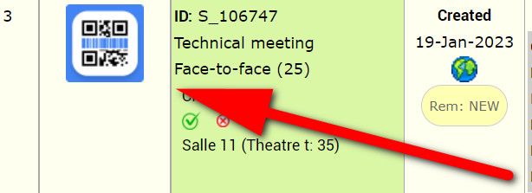
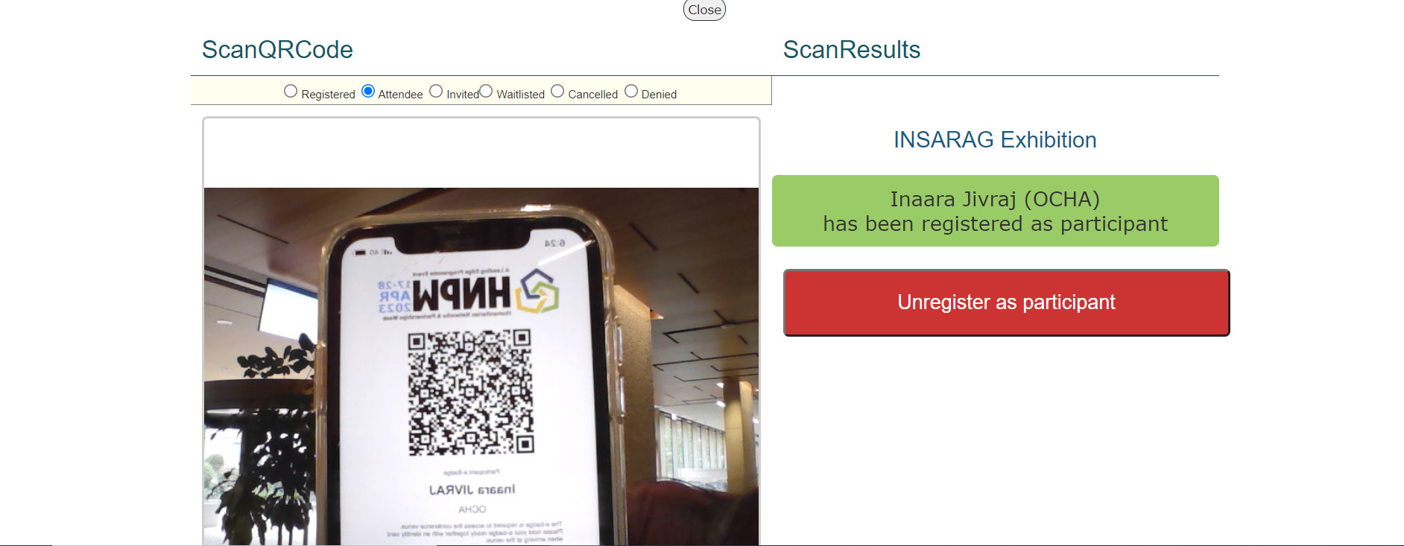
SESSION ATTENDANCE TRACKING
Track participant attendance for your sessions/exhibitions to create contact lists using your mobile device or laptop
Step 1:
Log into your session organizer (on mobile OR laptop)
account at www.hnpw.org
Step 3:
Click the QR Code logo next to the session/exhibition
you want to register participants for
Step 2:
Click on "sessions you can edit"
Step 4:
Scan the participant's e-badge using the camera feature

